Slide 1
Correlation
Vanessa LoBue
Jamil Bhanji
with a little help from Andy Field

Slide 2
Aims
Measuring Relationships
Scatterplots
Covariance
Pearson’s Correlation Coefficient
Nonparametric measures
Spearman’s Rho
Kendall’s Tau
Interpreting Correlations
Causality
Partial Correlations

Slide 3
What is a Correlation?
It is a way of measuring the extent to which two variables are related
It measures the pattern of responses across variables

Slide 4
Notes:
Appreciation of Norwegian Black metal Band Dimmu Borgin against age

Slide 5
Measuring Relationships
We need to see whether as one variable increases, the other increases, decreases or stays the same
This can be done by calculating the covariance
We look at how much each score deviates from the mean.
If both variables deviate from the mean by the same amount, they are likely to be related

Slide 6
Variance (review)
The variance tells us by how much scores deviate from the mean for a single variable
Covariance is similar—it tells is by how much scores on two variables differ from their respective means

Slide 7
Covariance
Calculate the error between the mean and each subject’s score for the first variable (x).
Calculate the error between the mean and their score for the second variable (y).
Multiply these error values.
Add these values and you get the cross product deviations.
The covariance is the average cross-product deviations

Slide 8
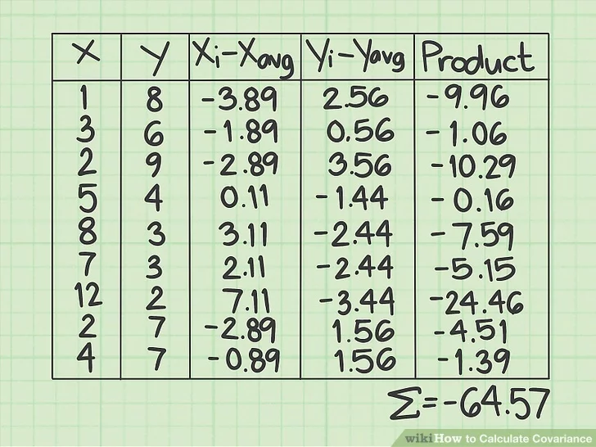
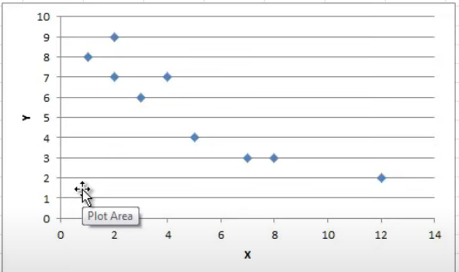
Covariance

Slide 9
Problems with Covariance
It depends upon the units of measurement
E.g. The covariance of two variables measured in Miles might be 4.25, but if the same scores are converted to km, the covariance is 11
One solution: standardise it!
Divide by the standard deviations of both variables
The standardised version of covariance is known as the correlation coefficient – equivalent to the covariance of the standardized variables
Notes:
Comment on the repeated theme (analagous to sum of squares problem for variance)

Slide 10
Things to know about the correlation
It varies between -1 and +1
0 = no relationship
It is an effect size
±.1 = small effect
±.3 = medium effect
±.5 = large effect
Coefficient of determination, r²
By squaring the value of r you get the proportion of variance in one variable shared by the other.

Slide 11
Correlation and Causality
The third-variable problem:
In any correlation, causality between two variables cannot be assumed because there may be other measured or unmeasured variables affecting the results.
Direction of causality:
Correlation coefficients say nothing about which variable causes the other to change

Slide 12
Conducting Correlation Analysis

Slide 13
Nonparametric Correlation
Spearman’s rho
Pearson’s correlation on the ranked data
Kendall’s tau
Better than Spearman’s for small samples

Slide 14
Partial Correlations
Partial correlation:
Measures the relationship between two variables, adjusting for the effect that a third variable has on them both

Slide 15
Partial Correlations
partial correlation is the relationship between X and Y accounting for the overlap in X and Z and Y and Z
The partial correlation between Performance and Anxiety accounting for Revision Time is the unique variance in exam performance shared with exam anxiety (A) expressed as a proportion of the variance in exam performance not shared with revision time (A+E)

Slide 16
Semi-Partial Correlations
Semi-partial correlation:
A measure of the relationship between two variables while adjusting for the effect that one or more additional variables have on one of those variables.
If we call our variables x and y, it gives us a measure of the variance in y that x alone shares

Slide 17
Semi-Partial Correlations
semi-partial correlation is the relationship between X and Y accounting for the overlap in X and Z, but not the overlap in Y and Z
The semi-partial correlation between Performance and Anxiety accounting for Revision Time is the unique variance in exam performance (A) shared with exam anxiety expressed as a proportion of the variance in exam performance (A+C+E+B)

Slide 18
Categorical variables: Contingency Table
Analyzing two or more categorical variables
The mean of a categorical variable is meaningless
The numeric values you attach to different categories are arbitrary
The mean of those numeric values will depend on how many members each category has.
Therefore, we analyze frequencies.
An example
Can animals be trained to line-dance with different rewards?
Participants: 200 cats
Training
The animal was trained using either food or affection, not both)
Dance
The animal either learnt to line-dance or it did not.
Outcome:
The number of animals (frequency) that could dance or not in each reward condition.
We can tabulate these frequencies in a contingency table

Slide 19
A contingency table
Strength of the assocation between categorical variables can be quantified with a contingency coefficient or Cramer’s V – reviewed in today’s lab activity

